Slide 1
THE PSYCHOLOGY OF LAWYERING
A discussion of what it means to be a mentally healthy lawyer.
Andrew Lillie, Elizabeth Titus, and Laura Groen

Slide 2
Agenda
Share our experience and observations
Invite open discussion
Introduce questions and tools for exploration
Notes:
Introduction:
Purpose of today: open discussion, become more comfortable with the conversation around the psychological challenges lawyers face (beyond addiction CLEs)
We are not therapists or experts in mental health. We are humans and lawyers. I am a former practicing corporate lawyer who now works with lawyers on many of these challenges.
We will speak in generalizations and share based on our experiences. Not all of these will apply to you. Invite you to approach the discussion with curiosity, if this is 5% true for me, would it be helpful to know that? If this may be true for my team, could it be resourceful to know that?
(Andy) Why you chose this topic/why it is important to you and what you hope everyone leaves with today.
Take-aways: It’s not just you. We should talk about it. There are tools. We want people to feel our openness.

Slide 3
Andrew Lillie
Holland & Hart Partner
Elizabeth Titus
Holland & Hart Partner
Laura Groen
Novus Global
Lawyer, Executive Coach to Lawyers
Notes:
Brief who we are (everyone introduce themselves)
Liz and Andy, will you add pictures and adjust your names if you’d rather go by Liz and Andy?

Slide 4
Common Psychological Challenges of the Profession
Notes:
Occupational Hazards

Slide 5
We are classic high performers: simultaneously stressed and bored.
Notes:
High performers reach for and are guided by the next available achievement. Do well in undergrad or attend a certain school to get into a certain law school. Achieve x accomplishments in law school to get a certain kind of offer or opportunity. Rise to the top to be on “partner track.” Work to gain respect/prove yourself as a partner. All well and good, unless you are reaching for the rung simply because it is the next rung, not because you know why or what for, leading to the boredom piece. Or they reach the end of the ladder, ok I’m a partner, now what?
High performers tend to live in survival mode (fire-drill to fire-drill) until they hit burnout or an existential crisis. They are working hard, they don’t necessarily know why. They “rest” when they crash and it’s more recovery than rest.
Liz: what is your experience with this one?
As we will discuss more later, high performer that does not have a clear vision for what they want from their career and a clear commitment to rest is likely to face burnout.

Slide 6
Our stories limit us.
I have no control over my schedule.
My life is dictated by the wants/needs of the partner/client.
No one “likes” being a lawyer.
The reward for eating pie is more pie.
Busy = important.
There is no room for mistakes.
Passion = naive.
My value is in my availability.
Notes:
Cultures have stories, language and lore. And the law has its own. Here are some we identified. What do you notice about these?
Andy/Liz: Relate to these, are they familiar? Where has a story you’ve adopted limited you? What experience is created by these stories?
Are any of these new to you? Any others, space for you to write these or add to them in the handout.
“It is what it is.” “Just the way it is.” Disempowered. I don’t have control. Carried by the current and I either accept/surrender or get out altogether. No in-between. May even feel comfort in the lack of control: I have a lot things I “should” be doing but now I have a reason to disappear into my work and everyone understands because that is the life of lawyer. We’ll talk about our option with these stories more in a bit.

Slide 7
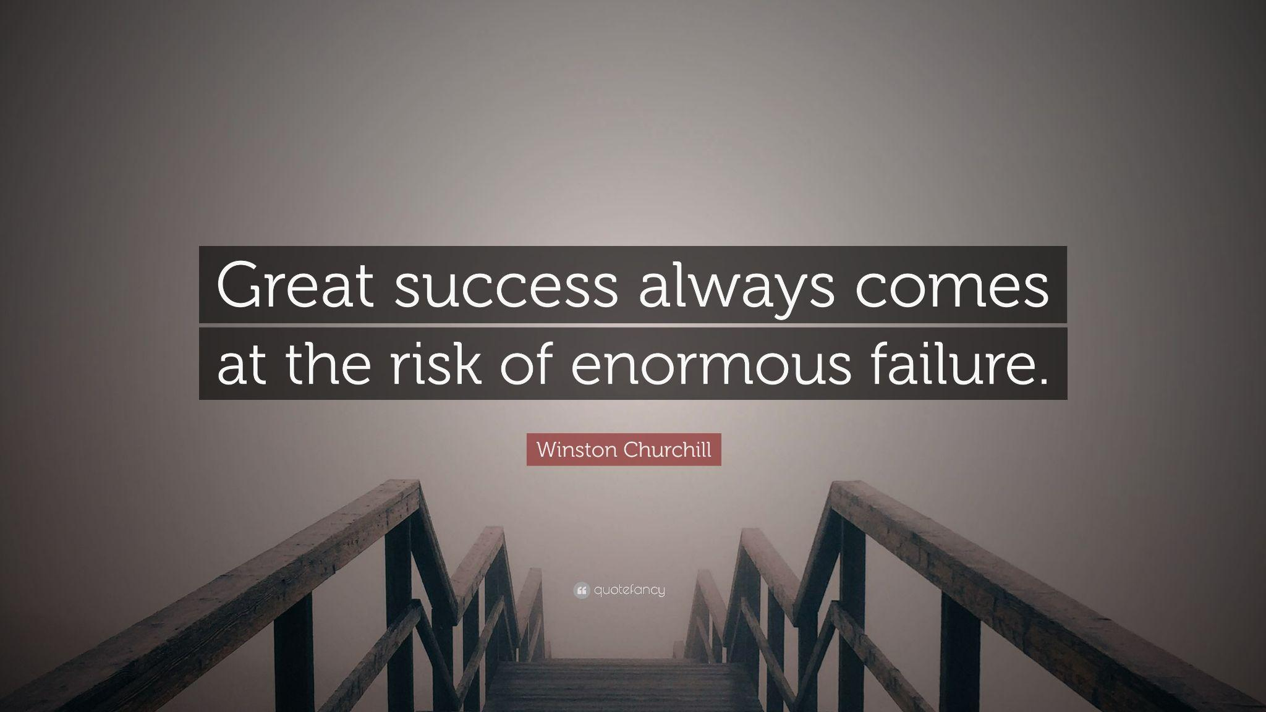
We highly value risk aversion.
Paid/rewarded to assess risk and avoid it.
But risk and growth often go hand-in-hand.
Healthy v. unhealthy risk.
Notes:
Think back on moments of major growth in your life. Stories of turning points. Were they void of risk?
When you spend most of your time working and working involves a risk avoidance mentality, it is easy for that mentality to creep into all arenas of our lives. I’ve known lawyers for whom risk avoidance has contributed to addiction or unhealthy risk in relationship because they are searching for the energy hit that risk brings.
Andy/Liz, do you/how do you counteract risk aversion to give yourselves growth opportunities? (Or how would you like to?)
Take a minute: When is the last time you took a risk for the possibility of growth? The last time you failed? Your last big swing that could have been a homerun or total whiff.
What in your life is important enough to risk failure for?

Slide 8
FEAR: We need it. But too much could destroy us.
Notes:
The Face of War, S. Dali.
Laura to ask all kinds of great questions.
Is everything we want on the other side of fear? What does it mean to have the right amount of fear? What is too much?

Slide 9
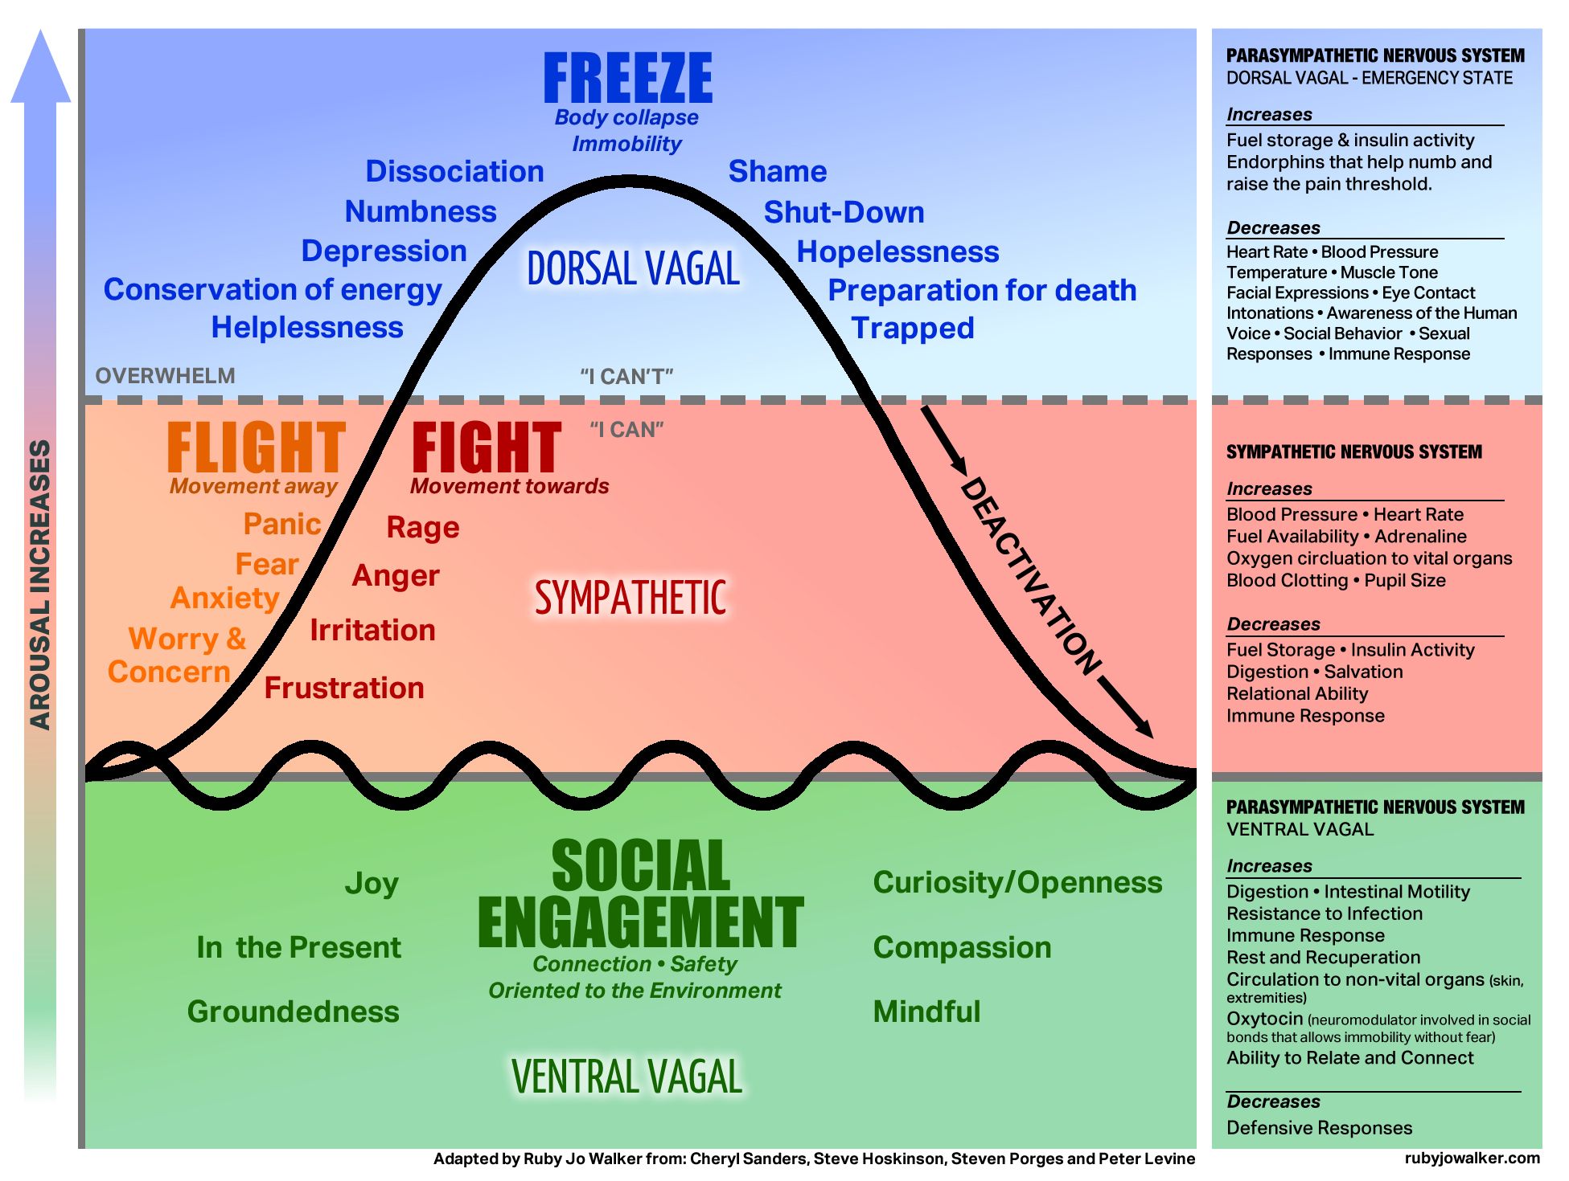
Understanding how our brains work will make us better lawyers.
Notes:
Polyvagal Chart. Andy and Liz to explain. Ask Liz about fight/flight example.
The reptilian brain is composed of the basal ganglia (striatum) and brainstem: primitive drives related to thirst, hunger, sexuality, and territoriality, as well as habits and procedural memory (driving, leaving your bag near the door, etc.).
Fight, flight, freeze in response to various kinds of danger.
The paleomammalian (old mammal) brain includes the hypothalamus, hippocampus, amygdala, and cingulate cortex: also primitive. It’s the center for motivation, emotions, and memory, and some genetically inherited behaviors (parenting urgest, etc.)
The neomammalian (new mammal) brain, the neocortex, is where language, abstraction, reasoning, and planning happen. This makes us human. This is where we make rational, thoughtful, logical, and good decisions.
Learning how to engage your human brain (the “neomammalian” brain), and how to disengage your reptile brain, is key.
Green level behaviors:
Say hello. Say good morning. Say those things in your emails.
Be compassionate and empathetic.
“Thx” and “Pls” are not words; don’t use unless you’re texting.
Ask how your colleagues, opposing counsel, clients are doing, and how their families are doing.
Every single day we exist as lawyers is a day that we exist as human beings with human needs, sensitivities, and concerns.
Sometimes the smallest, most seemingly insignificant gestures of goodwill can change a person’s day, week, month, or life.
Acknowledge good work/effort of others. Openly and often.

Slide 10
She who finds everything that is wrong wins.
Problem-spotting praised and rewarded.
Skeptical/cynical/suspicious mindsets.
Perfectionism.
Do we find these difficult to shed when we leave work, when we interact with colleagues, when we think about the future?
Notes:
(Similar to risk aversion) Part of the job is spotting the error, having a high value for (and likely unrealistic expectation of) perfection. Do you notice every typo menu. Are you carrying everything that might go wrong on your family vacation. Where does this mindset that is a tool in our work creep into arenas where it would be more helpful to us to leave it behind? Where does it impact your relationships? (If you don’t think it does, it may be valuable to gather data on that - i.e. ask the people around you).
Where does skepticism help you and where does it hold you back?
Where would it be beneficial to you to lean into identifying everything that is right?

Slide 11
Tools to Consider and Questions to Ponder

Slide 12
We are professionals.
We have privileges and responsibilities–by law.
Consider this: one of those responsibilities is caring for ourselves.
Notes:
Talk about basic things. Eating, drinking, exercise, etc. But the biggest point is that we are given privileges as members of this profession that require us to rise up to higher levels of responsibility than others in society. Without self-care, we can’t take care of others, whether our clients, our colleagues, or our friends and family. Consider this: without caring for your mental health, you cannot be the lawyer you want to be.

Slide 13
Articulate a vision: Do you know what you want?
The
Vision: A picture of the future that incites energy.
A helpful vision is specific, exciting, and out of reach.
Vision is a muscle to use or lose.
Invite someone in. Don’t go alone.
Notes:
Ancient proverb: Where there is no vision, the people perish.
What do you want for the next year? For the next 5? 10? Do you know why you are in your current position and could you express it to another human? Have you?
Specific because vague is an avoidance strategy. Exciting enough to get you through endless discovery requests, energy is leveraged here. Out of reach to require and inspire growth!
Lazy river analogy?
Andy/Liz: Struggles or reactions to vision?

Slide 14
Take ownership: “The firm” doesn’t really exist.
Notes:
There is no monster, no false-god/parent/overlord that we need to bow down to, to impress, to ask for advancement, to give us what we want and need. But it’s easier to think that there is. That’s a problem, and creates PTSD. Who do you mean when you say the firm, who are those people and have you provided them with your thoughts and feedback? One way to avoid ownership is to create a persona for an organization that is really just people, like us.

Slide 15
The
Therapy is not a dirty word.
Notes:
ANDY/LIZ: I’m leaning on you for this section. How has therapy helped you with any of the challenges we’ve discussed. How has your openness about it benefitted your teams/colleagues? We should all talk about mental health and be open about it. Bring all of yourself to your work. Leading, taking the high road, setting examples, caring about inclusivity, caring about how we act in public, taking our oaths seriously, being officers of the court, having more privileges and more responsibility than other citizens.

Slide 16
Evaluate Current Reality: Are your strategies working?
The
Stories: Are they helping or hurting? What are the new stories?
Risk/Fear: What vision would be worth the fear of failure? What outcome is worth the pain of growth?
Mindset: How might problem-spotting help you toward the vision? How might it hinder you? Instead of “what is wrong,” “what is possible”?
Rest: Do you have a vision for rest? What would a commitment to rest look like? Who could you invite?
Notes:
Hard to do surgery on yourself. Difficult to spot the errors in your own brief. Invite someone in.

Slide 17
What is one small step you can commit to today
to care for your psychological well-being?
A deep breath that helps you feel better?
A gesture to care for your team?
A clear vision for what you want?
Notes:
Closing thoughts?

Slide 18
The

